Slide 1


Wheat Ontology
Overview and introduction

Slide 2
Interoperability & Reusability: Semantic
FAIR

Slide 3
Semantic
Define concepts: plant, micro_plot, phenotype, experiment, event
Define Relations: micro_plot contains plant
Common Vocabularies and ontologies
Agrovoc, Plant Ontology, Crop Ontology, Environment Ontology, …
Study
Genotype
Observation Unit
Factor
hasGenotype
Treatment
Treatments
Plant
Measure
contains
is-applied
contains
Value
Time
micro_plot
plot
Ontology

Slide 4


Semantic Inference
Uncouple
Data capture
Data analysis
Data reuse
Inference allows to format the data for a target use
Plant
hasGenotype
Genotype
hasGenotype
contains
Micro-Plot
factors
treatment
is-applied
contains
is-applied
Plot

Slide 5
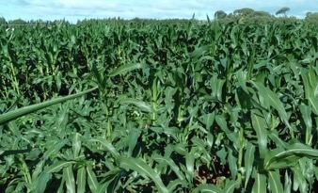
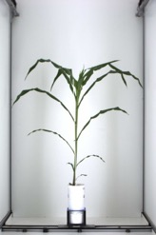

Annotation of events: plot and plant accidents
L. Cabrera-Bosquet & P. Neveu
anno480
oa:hasTarget
Plot 97
Plot 98
plot97
dcterms:creator
dcterms:created
oa:bodyValue
"2017-06-29”
‘Plots lodged after the storm’
Romain
anno86
oa:hasTarget
plant795
dcterms:creator
dcterms:created
oa:bodyValue
"2017-05-15”
‘Fallen plant during imaging’
Llorenç
Events or follow the Web Annotation Data Model that allows assigning motivation and purpose attributes to annotations (e.g. oa:describing, oa:identifying, oa:linking, oa: replying, etc.). Dublin Core properties such as dcterms:created or dcterms:creator are also used.

Slide 6
CROP ONTOLOGY
www.cropontology.org
Elizabeth Arnaud, Marie Angélique Laporte et al.

Slide 7


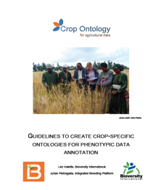
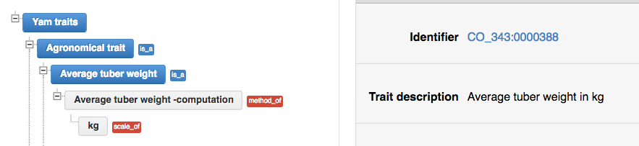
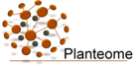
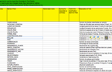

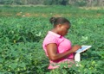
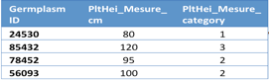
Crop Ontology for Trait Data
www.cropontology.org
27 Plants (latest Sugar Kelp - algae)
Good Practice for Trait Data Annotation
Submission of new traits & variables
Community selects traits and standard variables
Create Fieldbook with Ontology
Data collect
with standard variables
Formatted files in repositories or databases
Use of the formatted
data files

Slide 8



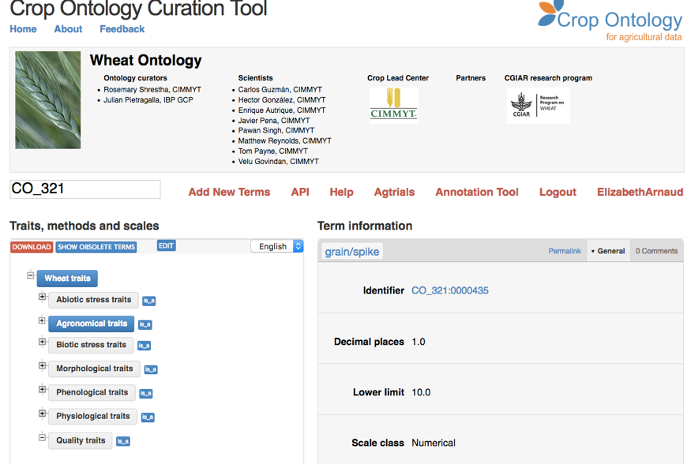
www.cropontology.org
Banana
Barley
Beet
Brachiaria
Brassica
Cassava
Castor bean
Chickpea
Common bean
Cowpea
Groundnut
Lentil
Maize
Mungbean
Oat (Global Triticeae)
Pearl millet
Pigeon Pea
Potato
Soybean (IITA & USDA)
Sweet Potato
Rice
Sorghum
Vitis (INRA)
Wheat (CIMMYT + INRAE)
Woody species
Yam

Slide 9




















Where is Crop Ontology applied?
WheatIS Interoperability
Cookbook
CGIAR
repositories
Notes:
BMS: At the source! Edition of fieldbooks
Agtrials= env 30 000 CO annotated trials

Slide 10


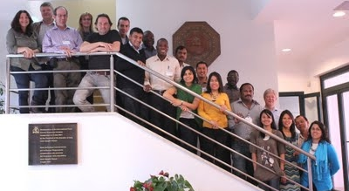
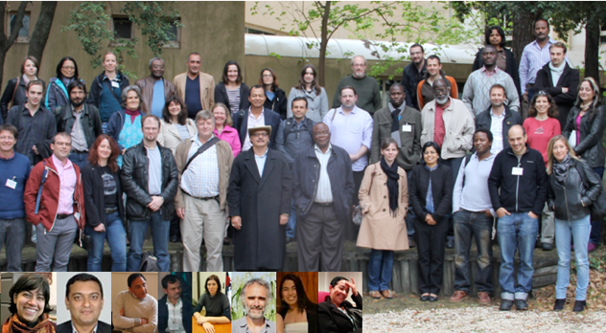
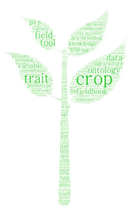
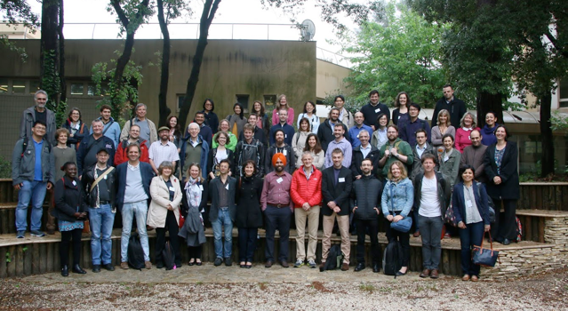
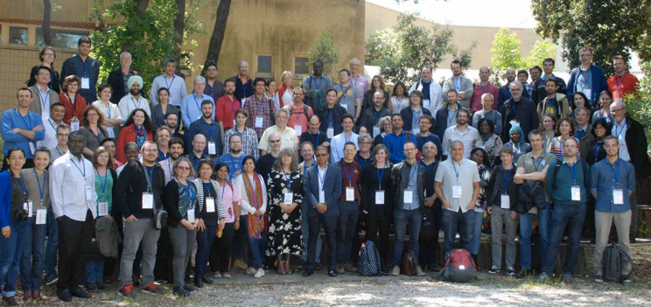
A Growing Community Of Practice
2012
2014
Upload your CoP Photo !
2016
2018

Slide 11




Provides measured traits, parameters and their standard variables for the Breeding fieldbook and for data annotation in the crop databases and their fieldbooks

Slide 12
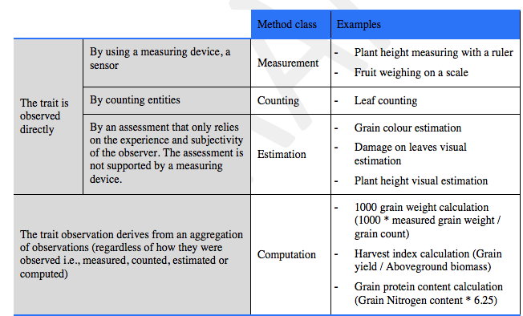
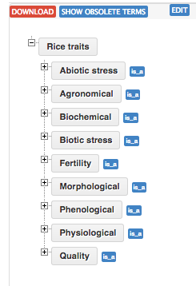
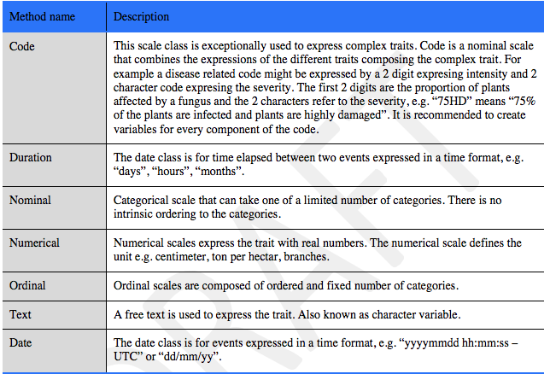
Classification of methods
Trait classes
Classification of scales
All traits, Methods , scales have
a definition

Slide 13

Reference Plant Ontologies
Mapping to species agnostic ontologies
to expand results of a crop trait search

Slide 14
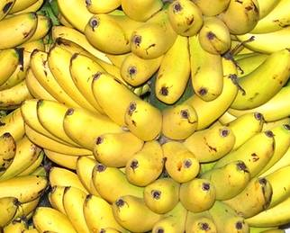
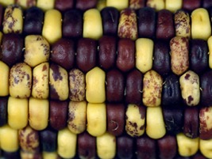
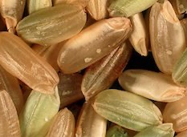
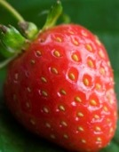
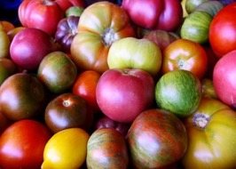
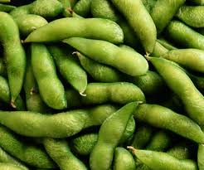
Specialized vocabularies
Finger Color
Kernel Color
Grain Color
Achene Color
Berry Color
Pod Color

Slide 15
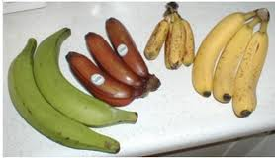

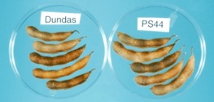
Common Reference Ontology
Finger color
Banana Trait Ontology
Fruit Color
Berry color
Pod color
Reference
Trait Ontology
Tomato Trait
Ontology
Soybean Trait Ontology

Slide 16


Common Reference Ontology
Finger color
Banana Traits
Fruit Color
Berry color
Pod color
Reference
Trait Ontology
Soybean Traits
Tomato Traits

Slide 17
Cropontology framework/Structure

Slide 18
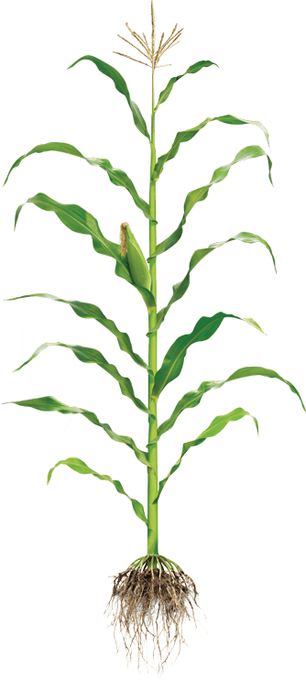
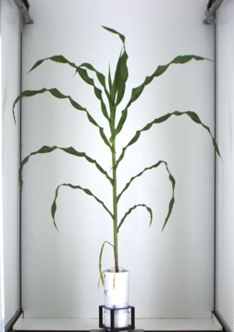
Variable : Plant height example
L. Cabrera-Bosquet & P. Neveu
measured variable described using the triple Trait + Method + Unit
+
+
Trait
Method
Unit
M1: Total height
M2: First tassel branch
M3: Last expanded leaf
M4: Youngest growing leaf
U1: cm
U2: mm
T1: Plant Height
M5: Highest pixel corresponding to plant
U3: pixel
…There is an innumerable combination…
…Each trait, method and unit has to be identified

Slide 19
Wheat CROP Ontology
https://doi.org/10.15454/3EDMCP
Cyril Pommier, Rosemary Shreshta et al.

Slide 20
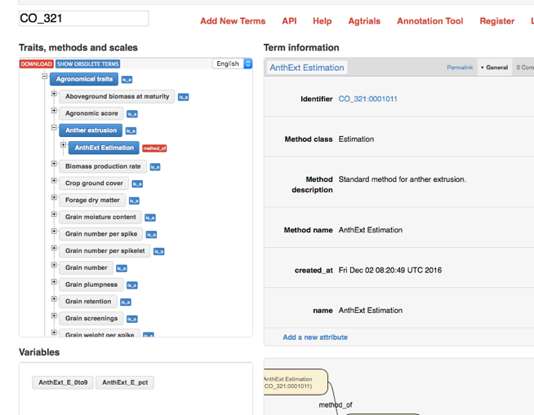
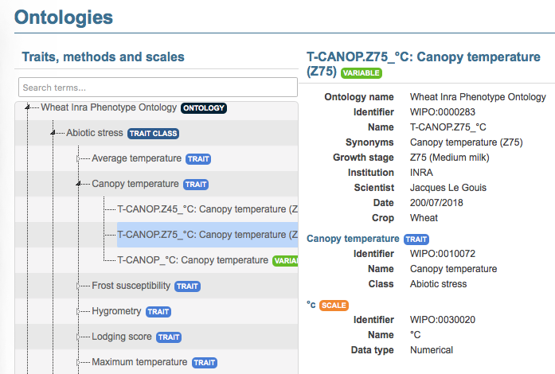
Wheat Trait Ontologies
CIMMYT Crop Ontology
CGIAR, IBP, INRAE …
497 variables
R. Shreshta, T. Letellier, J. Legouis, C. Pommier
http://www.cropontology.org/ontology/CO_321/Wheat
Wheat INRA Phenotype Ontology
WhealBI H2020, Breedwheat, Phenome-Emphasis.fr
50 variables
T. Letellier, J. Legouis
https://urgi.versailles.inra.fr/ontology#termIdentifier=WIPO:0000001

Slide 21
An ontology for Wheat
Description
Lists reference variables used for experimentations and observations organized following the Crop Ontology standard
International initiative based on various communities (CIMMYT, INRAE, Whealbi H2020, USDA (T3), … )
DOI : https://doi.org/10.15454/3EDMCP
English only
Access
GnpIS ontology portal
CropOntology
Ontology Lookup Service (EBI’s OLS)
AgroPortal
FAIRsharing

Slide 22


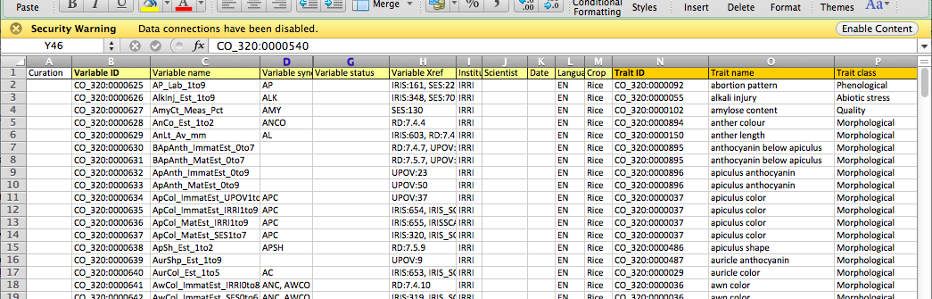
The Trait Dictionary (TD) template
Crop-specific vocabulary
Community-based development
Template and Guidelines :
www.cropontology.org
Notes:
SPECIES
FORMATTING

Slide 23










CropOntology workflow
Trait Dictionary Template v5

Slide 24
CropOntology Trait template
Variable | Variable ID
 | Variable name
 | Variable synonyms
 | Context of use
 | Growth stage
 | Variable status
 | Variable Xref
 | Institution
 | Scientist
 | Date
 | Language
 | Crop
Trait | Trait ID
 | Trait
 | Trait class
 | Trait description
 | Trait synonyms
 | Main trait abbreviation
 | Alternative trait abbreviations
 | Entity
 | Attribute
 | Trait status
 | Trait Xref
Scale | Scale ID
 | Scale name
 | Scale class
 | Decimal places
 | Lower limit
 | Upper limit
 | Scale Xref
 | Category 1
 | Category 2
 | …
 | Category n
Method | Method ID
 | Method
 | Method class
 | Method description
 | Formula
 | Method reference
Mandatory - Highly recommented - Optional

Slide 25
Variable creation
Trial | Genotype | CIR | HT | SUR
Domaine de Valcros | 6579 | 600 | 17 | 1
Domaine de Valcros | 6580 | 482 | 14 | 1
Trial | Genotype | H | CIR
La Nerthe | 6579 | 23 | 650
La Nerthe | 6580 | 28 | 514
Trait ID | Trait name | Trait class | Trait description | Trait synonyms
CO_357:1000070 | Survival | Stress | Assessment of the survival state of the tree | Health status
CO_357:1000012 | Tree circumference | Morphological | Circumference of the tree main stem | Tree girth
Main trait abbreviation | Alternative trait abbreviations | Entity | Attribute | Trait status
SUR | S, SR, ES, MOR | tree | survival | Standard for INRA
CIR | CIRC, Circ, CI, Girth | trunk | circumference | Standard for INRA

Slide 26
Variable creation
Trial | Genotype | CIR | HT | SUR
Domaine de Valcros | 6579 | 600 | 17 | 1
Domaine de Valcros | 6580 | 482 | 14 | 1
Trial | Genotype | H | CIR
La Nerthe | 6579 | 23 | 650
La Nerthe | 6580 | 28 | 514
Method ID | Method name | Method class | Method description | Method reference
CO_357:2000003 | Visual scoring | Estimation | Visual assessment with a reference scoring scale
CO_357:2000017 | Ribbon 130cm protocol | Measurement | Measured at 130cm from the ground (approximately breast height) with a graduated ribbon
CO_357:2000018 | Ribbon 1m protocol | Measurement | Measured at 1m from the ground with a graduated ribbon | http://www.csdhub.com/national-plant-specification/conifers/nps-conifers-girth/

Slide 27
Variable creation
Trial | Genotype | CIR | HT | SUR
Domaine de Valcros | 6579 | 600 | 17 | 1
Domaine de Valcros | 6580 | 482 | 14 | 1
Trial | Genotype | H | CIR
La Nerthe | 6579 | 23 | 650
La Nerthe | 6580 | 28 | 514
Scale ID | Scale name | Scale class | Decimal places | Lower limit | Upper limit | Scale Xref | Category 1 | Category 2 | Category 3
CO_357:3000036 | Survival scoring scale | Nominal | 0 | 0 | 2 |  | 0 = Alive | 1 = Dead | 2 = Doubtful
UO:0000016 | mm | Numerical |  |  |  | http://purl.obolibrary.org/obo/UO_0000016

Slide 28
Variable creation
Trial | Genotype | CIR | HT | SUR
Domaine de Valcros | 6579 | 600 | 17 | 1
Domaine de Valcros | 6580 | 482 | 14 | 1
Trial | Genotype | H | CIR
La Nerthe | 6579 | 23 | 650
La Nerthe | 6580 | 28 | 514
Variable ID | Variable name | Variable synonyms | Context of use | Variable status | Institution | Language | Crop
CO_357:0000082 | SUR | Survival, Health status, ES, S, MOR | Trial evaluation | Standard for INRA | INRA/IBET | EN | WoodyPlant
CO_357:0000019 | CIR | Tree circumference, Tree girth, C130, Ci130 | Trial evaluation, Breeding criterion | Standard for INRA | INRA | EN | WoodyPlant
CO_357:0000020 | CIR1 | Tree circumference at 1m, Girth at 1m, Circum | Trial evaluation, Breeding criterion | Standard for INRA | IBET/INRA | EN | WoodyPlant

Slide 29
Variable creation
Trial | Genotype | CIR | HT | SUR
Domaine de Valcros | 6579 | 600 | 17 | 1
Domaine de Valcros | 6580 | 482 | 14 | 1
Trial | Genotype | H | CIR
La Nerthe | 6579 | 23 | 650
La Nerthe | 6580 | 28 | 514
Variable ID | Variable name
CO_357:0000082 | SUR
CO_357:0000019 | CIR
CO_357:0000020 | CIR1
Trait ID | Trait name
CO_357:1000070 | Survival
CO_357:1000012 | Tree circumference
CO_357:1000012 | Tree circumference
Method ID | Method name
CO_357:2000003 | Visual scoring
CO_357:2000017 | Ribbon 130cm protocol
CO_357:2000018 | Ribbon 1m protocol
Scale ID | Scale name
CO_357:3000036 | Survival scale
UO:0000016 | mm
UO:0000016 | mm

Slide 30
First Hands On

Slide 31
Fill TDv5 for the following variables
AGM
The Above-ground matter of the plants have been harvested for a whole plot, dried out then weighted. The result has been expressed in grams by square meters and tons by hectares
Same measure as above but at anthesis rather than harvest.
Same but express the developmental stage using zadock (optional)
Grain Yield
The grain were harvested then weighted at 0% and 15% humidity. The result where expressed in q/ha and grams per square metters
Disease
Septoria was inoculated, the inoculation date being recorded as julian date, day of year and degree days. The Septoria score was evaluated on two leaves, with a 1 (Resistant) to 9 (Susceptible) notation scale. Agent: Mycosphaerella graminicola (Septoria tritici). Symptoms: the lesions are linear and restricted laterally. The following methods were used for measurement: Saari and Prescott, 1975; Eyal et al., 1987; Duveiller et al., 2012.

Slide 32
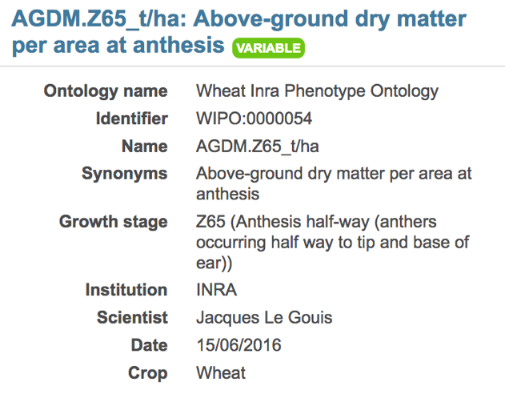
Wheat Variable exemple : Variable
Variable ID | Variable name | Variable synonyms | Context of use | Growth stage | Variable status | Variable Xref | Institution | Scientist | Date | Language | Crop
WIPO:0000054 | AGDM.Z65_t/ha | Above-ground dry matter per area at anthesis |  | Z65 (Anthesis half-way (anthers occurring half way to tip and base of ear)) |  |  | INRA | Jacques Le Gouis | 15/06/2016 | EN | Wheat

Slide 33
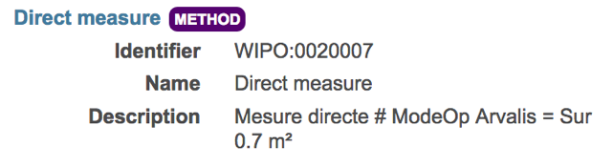
Wheat Variable exemple : Variable
Method ID | Method name | Method class | Method description | Formula | Method reference
WIPO:0020007 | Direct measure |  | Mesure directe # ModeOp Arvalis = Sur 0.7 m² |  | PDF URL + PAGE

Slide 34
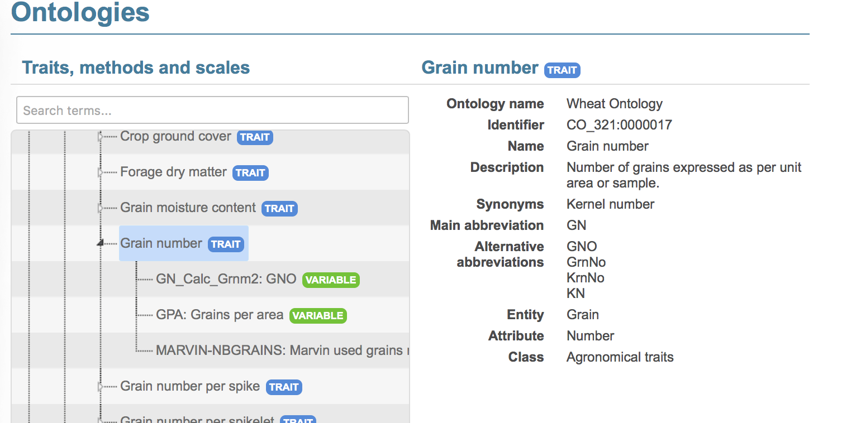
One Trait with multiple variables

Slide 35
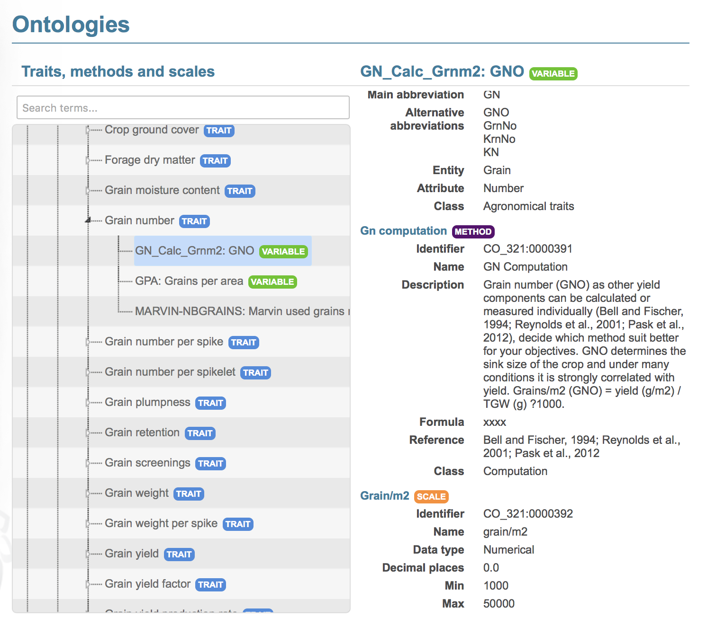
One Trait with multiple variables

Slide 36
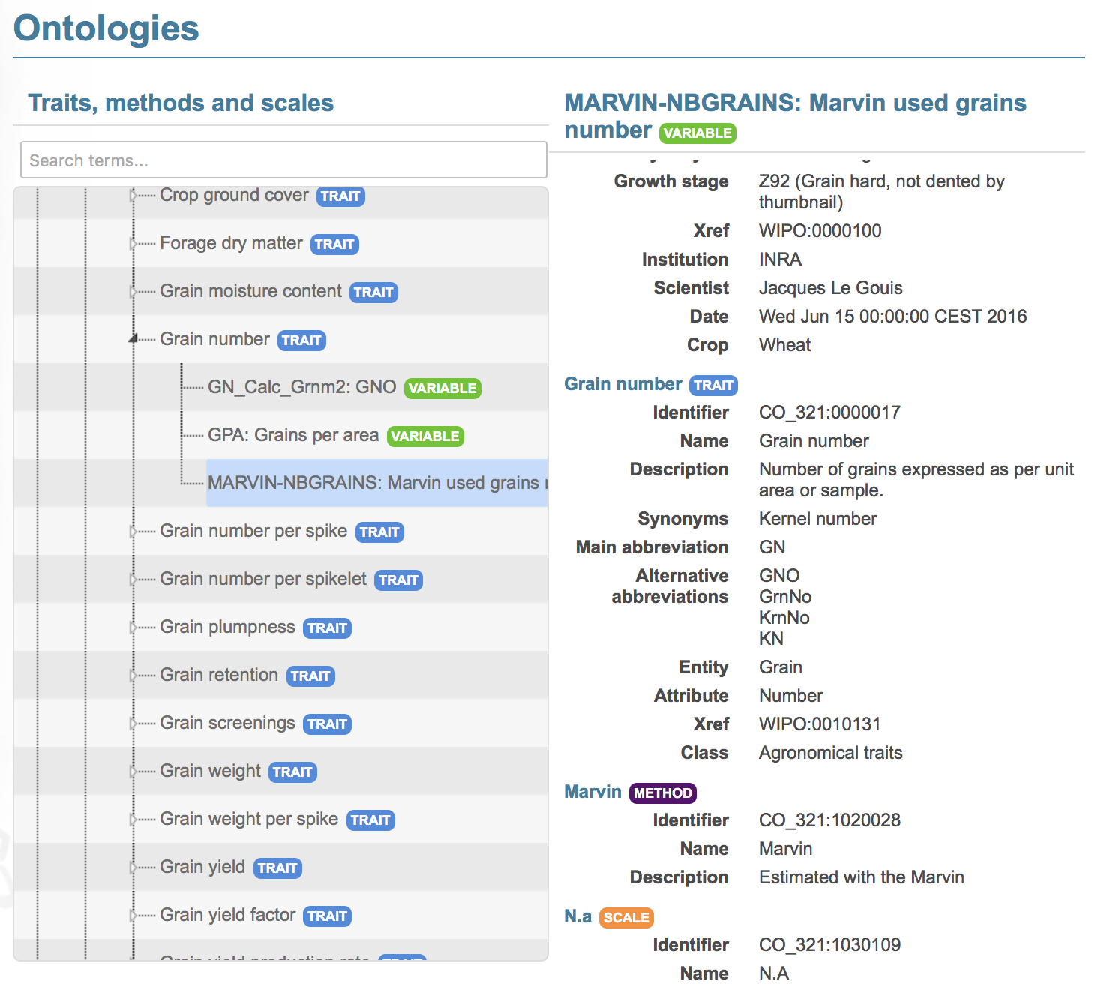
One Trait with multiple variables

Slide 37
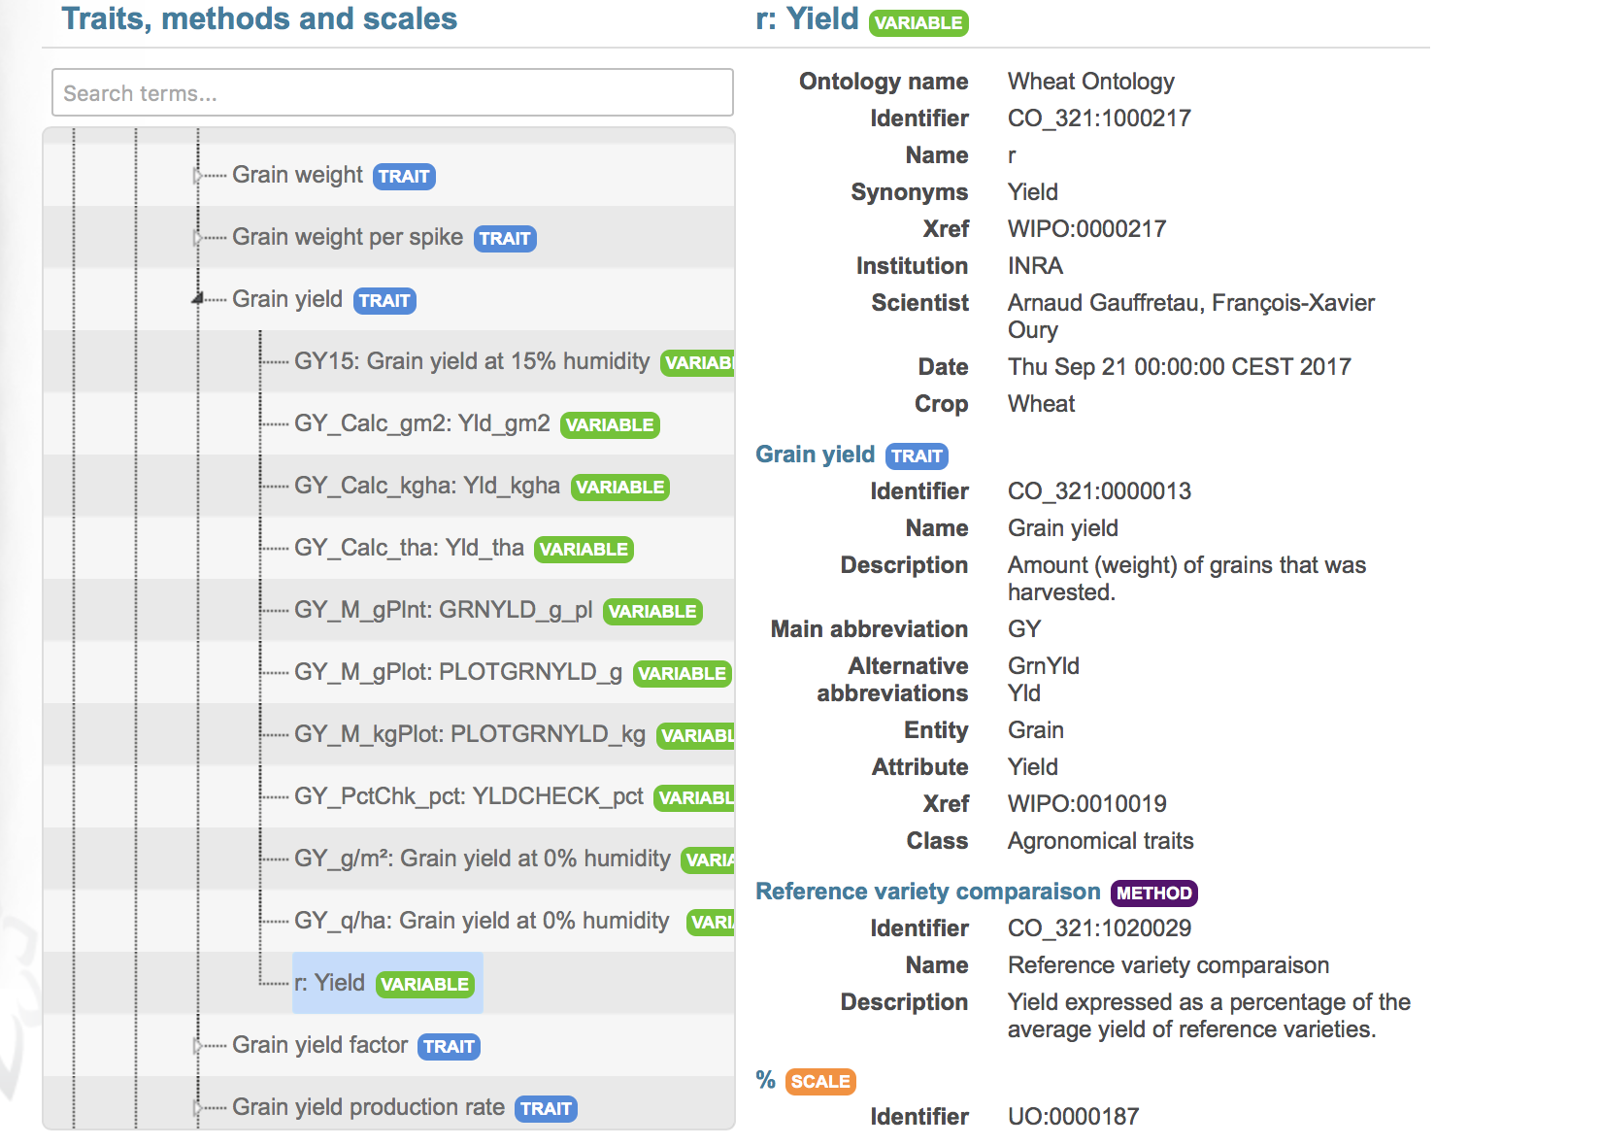
Yield: many variables

Slide 38
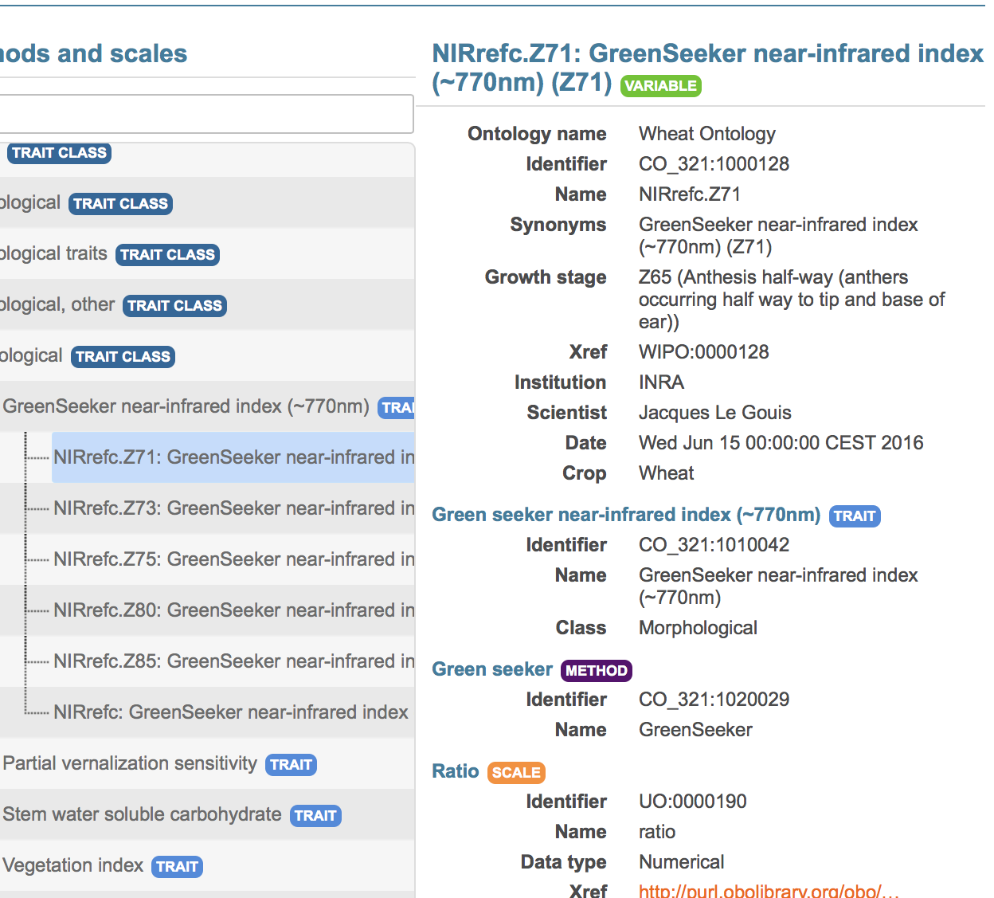
Variable by stage Combination
Usefull for genetic analysis but:
Number of variable combination explosion
Poor data reusability
Recommandation: One variable for the trait and one for the phenology. Then combine depending on your scientific question

Slide 39
Hands On
How many variables from the following description :
In the popyomics study of the populus canker lesion impact, the trees where inoculated with strains 98AR1 and 93CV1. The lesion lenght, ie the impact of the inoculation, was measured one and two years after inoculation.

Slide 40
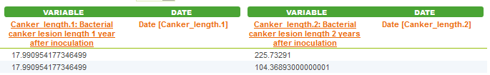
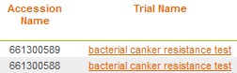
Variable annotation
Study | QTL | Trait | Trait description
POPYOMICS | Pop2_qtl1 | L98AR1 | Latent Period for strain 98AR1
POPYOMICS | Pop2_qtl2 | L93CV1 | Latent Period for strain 93CV1
POPYOMICS | Pop2_qtl3 | Canker_LL | Canker lesion length

Slide 41
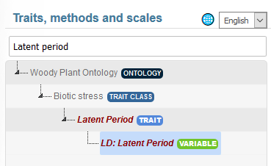
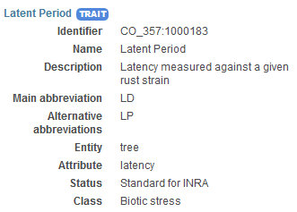
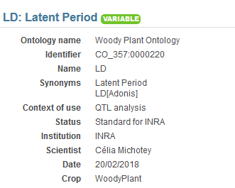
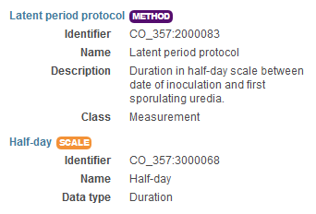
Variable annotation
Trait | Trait description
L98AR1 | Latent Period for strain 98AR1
L93CV1 | Latent Period for strain 93CV1
Canker_LL | Canker lesion length

Slide 42
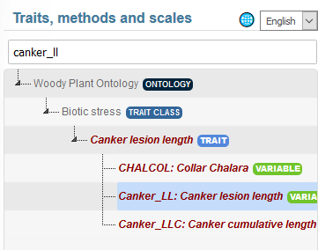
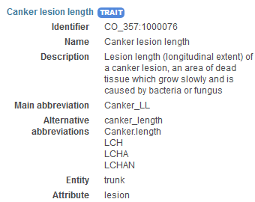
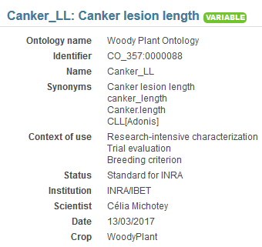
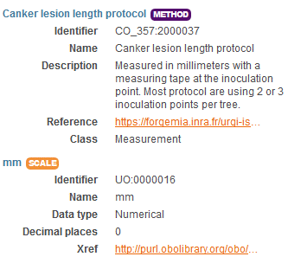

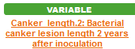
Variable annotation
Trait | Trait description
L98AR1 | Latent Period for strain 98AR1
L93CV1 | Latent Period for strain 93CV1
Canker_LL | Canker lesion length

Slide 43
Phenology handling, the woOdy plant ontology example

Slide 44
BBCH scale, Woody Plant ontology example
Scale used to identify the phenological development stages of plants
Bud development
Leaf development
Stem development and elongation
Flowering
Fruit development
Senescence
Uses a decimal code system, which is divided into principal and secondary growth stages
Woody BBCH
Development of a BBCH scale for Forest Plants by the project TEMPO (French network of observatories dedicated to phenology for the entire living kingdom) => homogenize variables and facilitate data links
BBCH-scale available in the Woody Plant Ontology

Slide 45
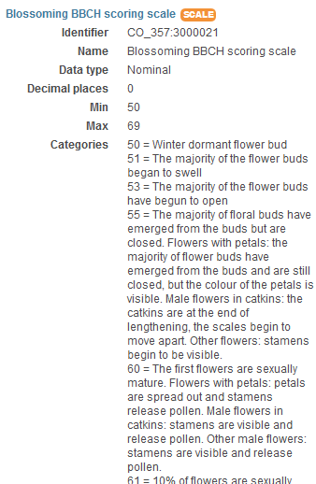
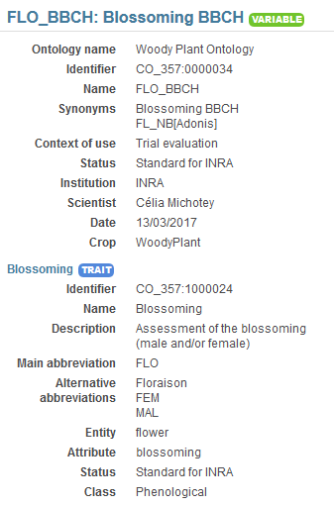


BBCH scale, Woody Plant ontology example

Slide 46
Application to your variables
Pick some relevant variables in your datasets
Describe them as text
Try to find corresponding variables in the crop ontology.
Format your variables using TDv5

Slide 47
How to contribute?
Create your variables
In an empty CropOntology template (Trait Dictionary template v5)
Or complete the last version of the Woody Plant Ontology
Use Crop Ontology github
https://github.com/Planteome/ibp-wheat-traits/issues

Slide 48



Variable viewer https://urgi.versailles.inra.fr/ephesis/ephesis/ontologyportal.do#termIdentifier=CO_357
Embed in your own web page/system
https://brapi.org/brapps

Slide 49


















Aknowledgment & Questions
Lukas Mueller
Peter Selby
Jan Erik Backlund
Živa Ramšak
Kristina Gruden
Paul Kersey
IPG PAS
Hanna Cwiek-Kupczynska
Pawel Krajewski
Rosemary Shreshta
Bioversity international CGIAR
Elizabeth Arnaud
Marie Angélique Laporte
Matthias Lange
Cyril Pommier
Anne Françoise Adam Blondon
Guillaume Cornut
Thomas Letellier
Célia Michotey
François Tardieu
Pascal Neveu
Manuel Ruiz
Pierre Larmande
Frederik Coppens
Richard Finkers
iBet
Bruno Costa
Inês Chaves
Célia M. Miguel
IGC
Daniel Faria
Bjorn Usadel

